Slide 1
Recent advances in robotics, automation and sensing
Prof. Tarek Sobh
Senior Vice President of Graduate Studies & Research
Dean School of Engineering
Distinguished Professor of Engineering and Computer Science
University of Bridgeport, USA

Slide 2
Introduction
Robotics is a relatively new field of modern technology that crosses traditional engineering boundaries
Robotics is a very interdisciplinary field involving all areas of science and engineering
Recent notable advances in area of Robotics
Exciting work done at the RISC lab, University of Bridgeport

Slide 3
State of the Art
Robot Swarms
Tele-robotic Surgery
Robots in the Army
Self-assembling Robots
Robots under water

Slide 4
Robot Swarms

Slide 5
teleRobotic Surgery
DaVinci Surgical System

Slide 6
The Little Dog & the big Dog !

Slide 7
Self-Assembling Robots
The FoamBot

Slide 8
Underwater Robots
HiBot ACM-R5

Slide 9
RISC Lab Projects
Interdisciplinary Robotics, Intelligent Sensing and Control (RISC) Lab
Founded in 1995
More than 600 scholarly publications
Research in the areas of mobile robotics, sensing, reverse engineering, prototyping manipulators, swarm systems,

Slide 10
RISC Lab Projects
Telerobotics Platforms (RISCBOT I & II)
Formula 1 Tire Changing Robot
Experimental Robot Musicians
Design and Prototyping of Task-Based manipulators
UBSwarm – Heterogeneous Robotic Swarm System

Slide 11
RISCBOT
Telerobotics - The ability to control robotic devices from a distance
RISCBOT I – An experimental telerobotic platform that can be controlled over the web
RISCBOT II – A high modular and scalable telerobotic system with plug-and-play architecture
Modular 802.11b – enabled mobile autonomous robot
Sensor fusion based navigation and manipulation
Navigation based on a visual recognition algorithm
Controlled via the internet to navigate to desired rooms
Online users receive real time video feedback

Slide 12
Riscbot I

Slide 13
Riscbot II

Slide 14
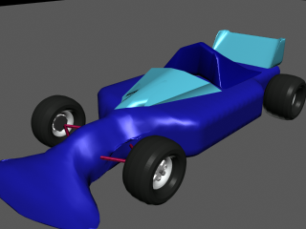
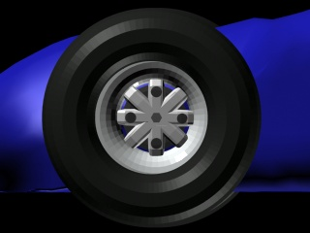
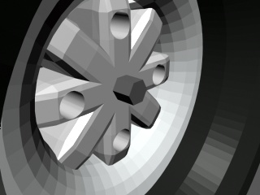
Formula 1 tire changing robot
A prototype of the racing car

Slide 15
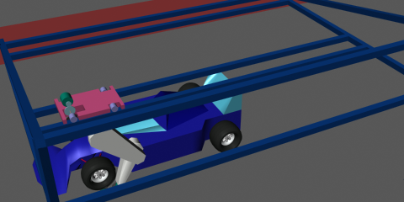
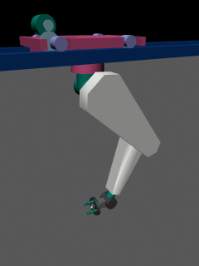
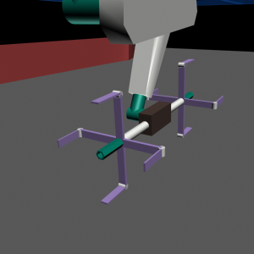
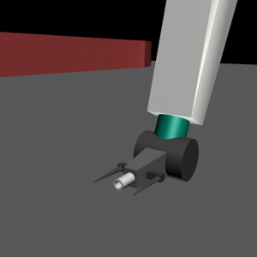
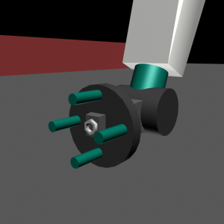
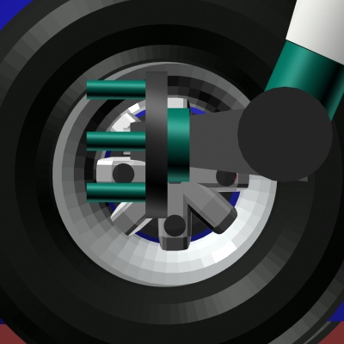
Formula 1 tire changing robot

Slide 16
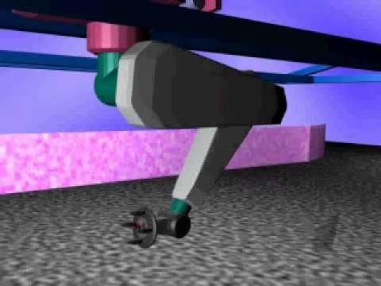
Formula 1 tire changing robot
This type of robotic system would replace the team required at each pit stop.
The risk factor will be reduced significantly.
Races will be more fair. Arms will change tires on different model cars within an estimated 0.3 second tolerance variance.
Dependance on team accuracy and training is eliminated.
The cost of this system is lower than the current team-based systems.

Slide 17
Experimental Robot Musicians
Robot musicians perform on real instruments through the usage of mechanical devices, such as servomotors and solenoids
Research innovations linking music, robotics and computer science
Offer the audience live-experience very similar to listening to a human musician.
Real instrument performance, such as the physical vibration of a violin string, provides a much stronger case in music expressiveness, versus electronic music synthesizers.
More degrees of freedom in real-time performances and reach a higher level of performance difficulty, flexibility and quality.
As an example, a violin is played by a robot musician with hands that have 12 fingers.

Slide 18
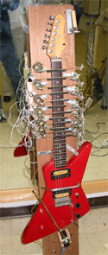
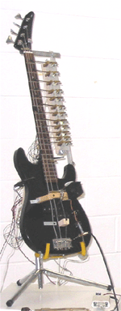
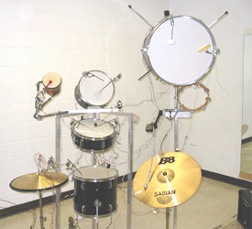
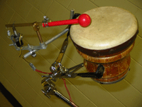
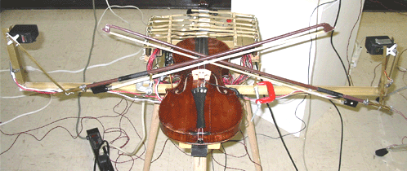
Experimental Robot Musicians

Slide 19
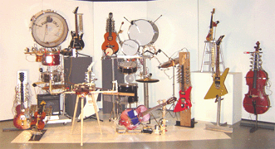
Experimental Robot Musicians

Slide 20
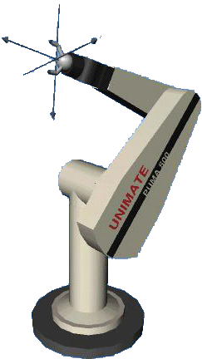
Design & Prototyping of task based manipulators
Designing manipulators based on user defined tasks and operating constraints
Workspace Dimensions
and Coordinates of the Task-Points
Restrictions on Manipulator
Configuration
Velocity and Acceleration
Requirements
Obstacles, Working Medium, and
Trajectory Biases

Slide 21
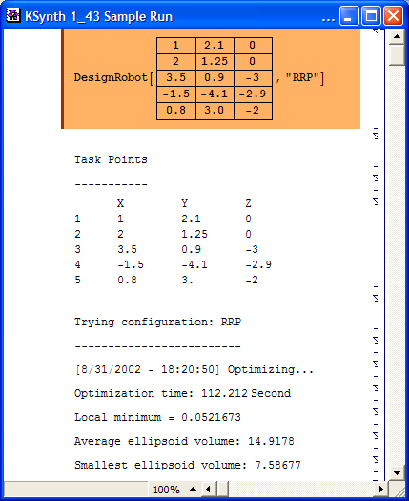
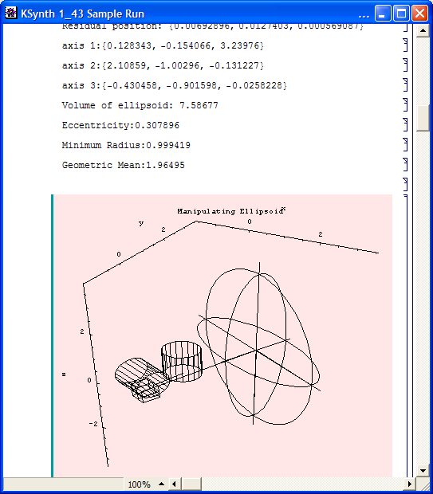
Parametric Optimization
Maximizing the Manipulability

Slide 22
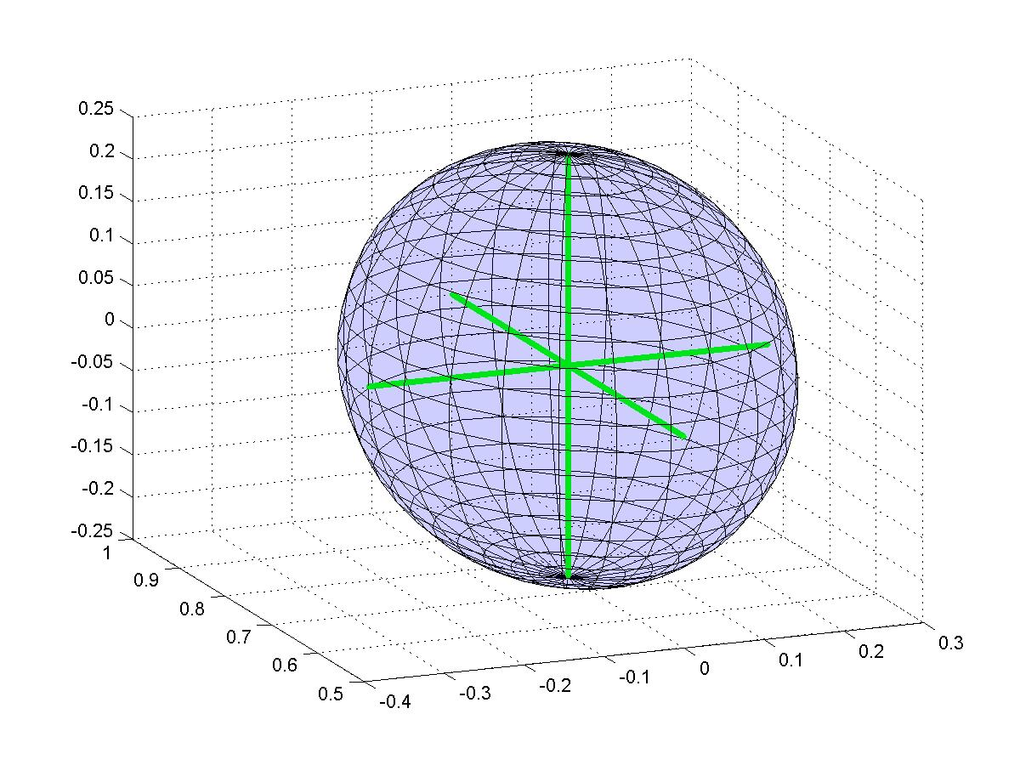
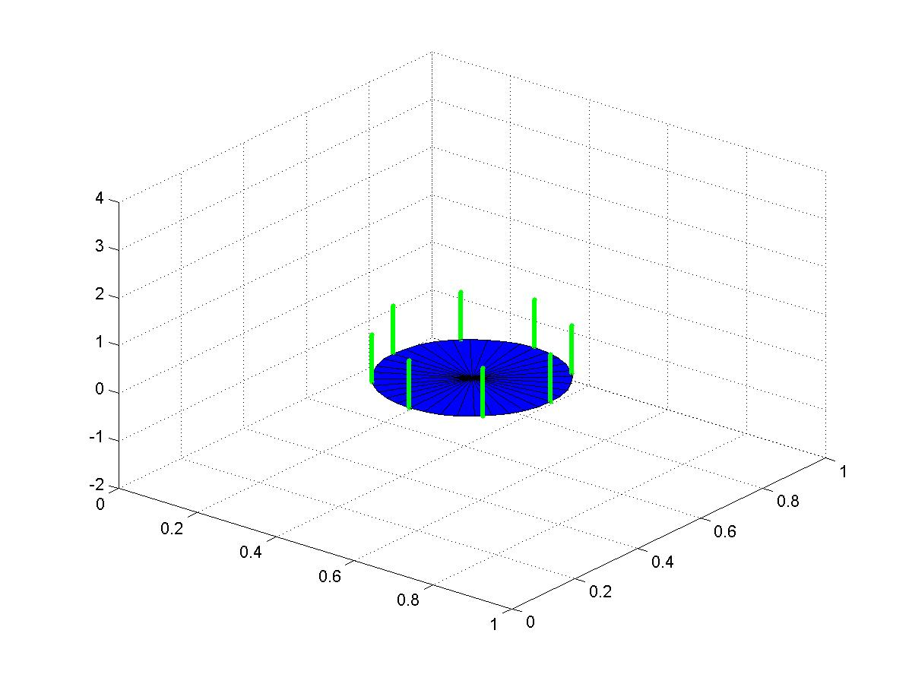
Task-Based optimization
Spherical Goal Task
Ring Goal Task

Slide 23
Soft computing techniques
Particle Swarm Based Inverse Kinematics
Simulated Annealing for Structure Optimization

Slide 24
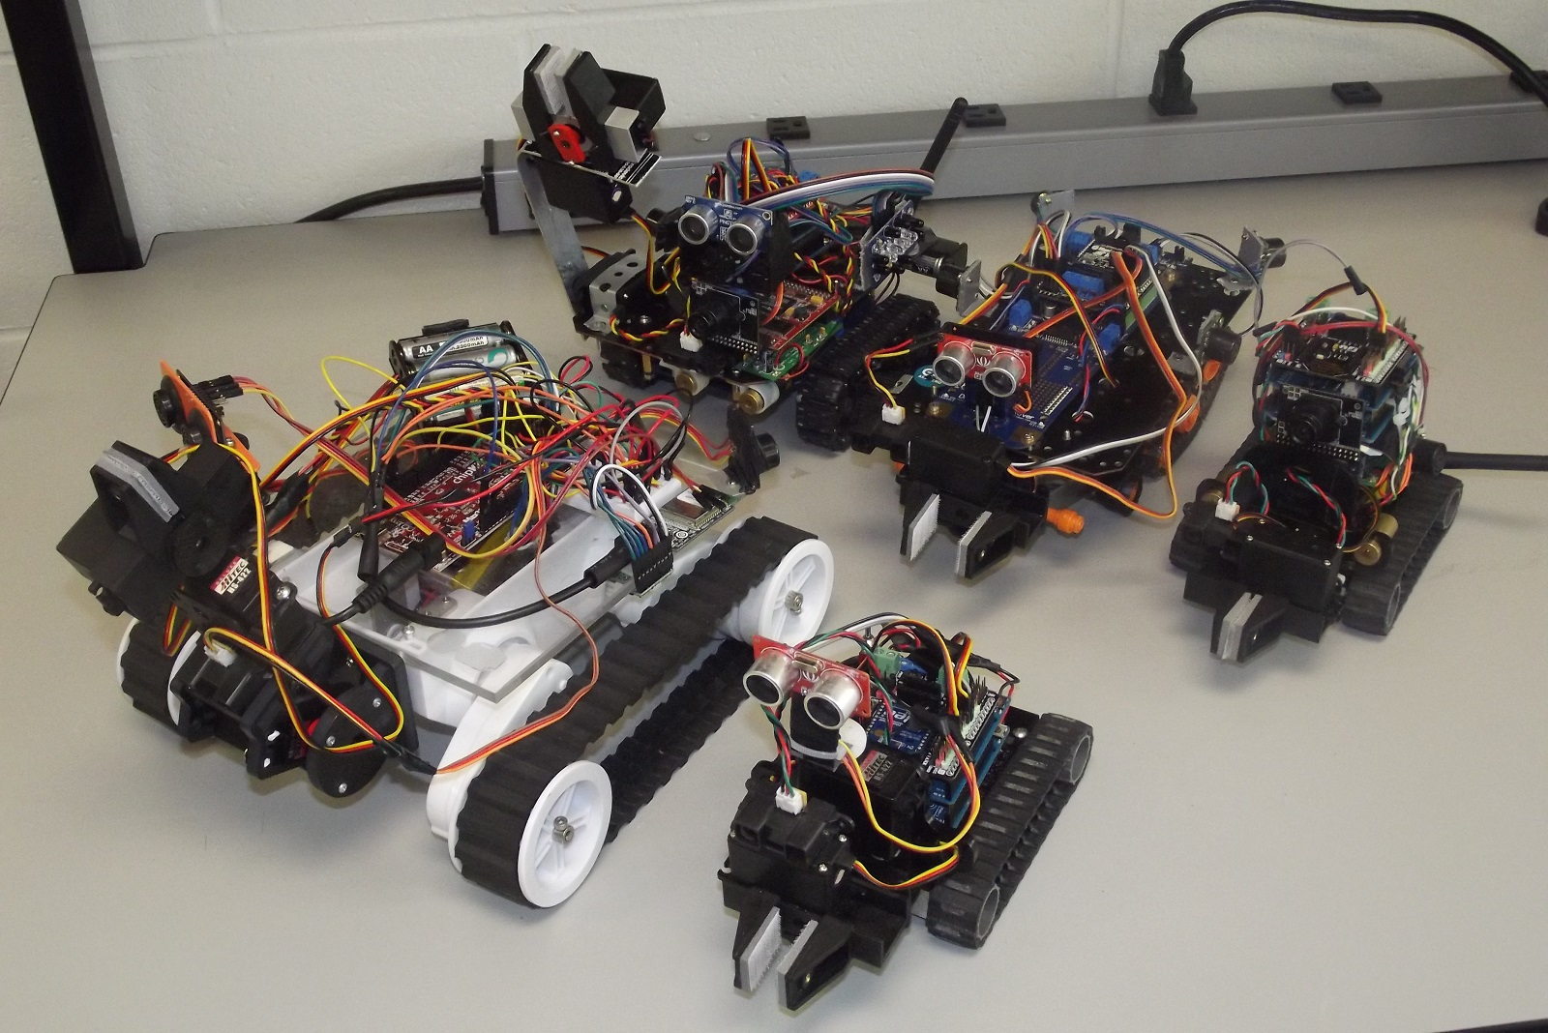
UBSwarm – Heterogeneous robotic swarm

Slide 25
Mapping as a swarm

Slide 26
Human rescue

Slide 27
Thank you !!
For more info on our current and past projects
Google – ‘RISC Lab, University of Bridgeport’
Or visit http://tareksobh.net

